Slide 1
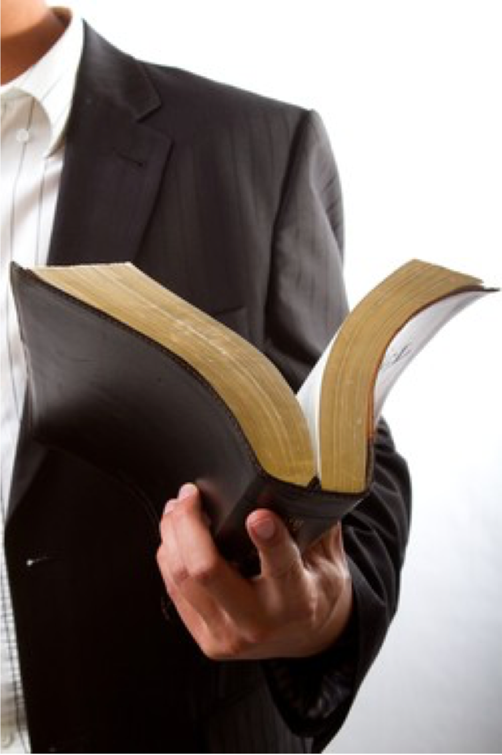

Why Do We Believe
What We Believe?
THE SOURCE
THE SEARCH
THE METHOD
THE APPLICATION
THE RESULT
Acts 17:11-12

Slide 2

I BELIEVE WHAT I DO …
Why do we believe what we believe?
NOT merely because of what I was taught as a child. (Acts 22:3; 23:6; Philippians 3:4-10; 2 Timothy 1:5)
NOT because it is the “orthodox” position held by learned men. (Acts 23:6; Philippians 3:4-10; Matthew 15:7-9; Romans 1:22; 10:1-3; Galatians 1:6-9; 1 Corinthians 1:20-25; Colossians 2:8-10)
NOT because it is what my family and friends believe. (Luke 14:25-27; Matthew 10:37; Philippians 3:8)

Slide 3
I BELIEVE WHAT I DO …
Why do we believe what we believe?
NOT Because it is convenient. (Acts 24:25; Luke 9:23-26; Matthew 7:13-14; 2 Timothy 3:12)
NOT Because it is what I want to believe. (Isaiah 30:9–11; Jeremiah 5:30; 10:23; Romans 1:24-25; 2 Timothy 4:3-4; 2 Thessalonians 2:10-12)
NOT Because of my emotional feelings or current circumstances. (Proverbs 28:26; Jeremiah 17:9; Proverbs 14:12; 16:25; Ephesians 4:14; Romans 16:17-18)

Slide 4
I BELIEVE WHAT I DO …
Why do we believe what we believe?
Because I was taught as a child to believe what the scriptures teach, NOT what men teach. (Acts 17:11-12;
John 20:30-31; 1 Peter 4:11)
Because I have searched, and continue to search the scriptures to prove what I believe. (Acts 17:11-12; 2 Timothy 2:15; 3:16-17)
Because I know God’s word is TRUE and anything different from what God says is false. (Romans 3:4; 10:17; John 17:17)

Slide 5

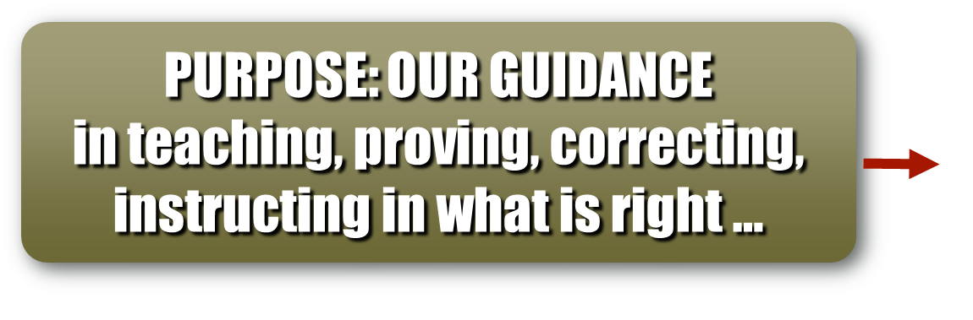
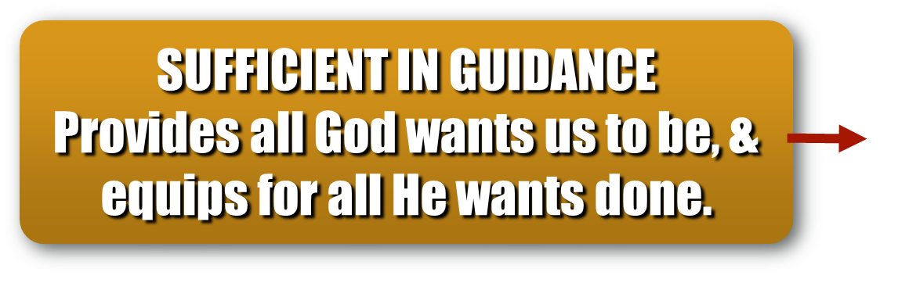
The Bible Is Only Valid Source
Why do we believe what we believe?
“All scripture is inspired by God and profitable for teaching, for reproof, for correction, and for training in righteousness, that the man of God may be complete, equipped for every good work.” (2 Timothy 3:16-17)

Slide 6


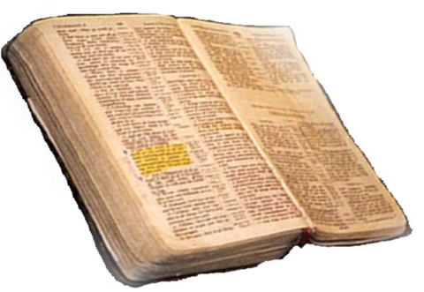
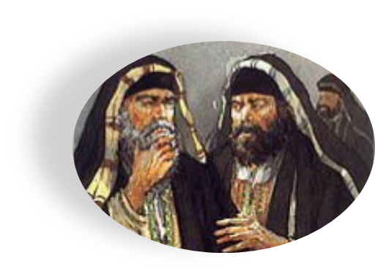


“The baptism of John – where was it from? From heaven or from heaven?” (Matthew 21:25,26)
From Heaven
Matthew 21:23-27
1 John 4:4-6
Galatians 1:6-9
Colossians 2:6-10
2 Thessalonians 2:15
From Men
Matthew 15:1-9
1 Corinthians 4:6
Galatians 1:10-17
Colossians 2:8
2 Thess. 2:2-4
ONLY TWO
POSSIBLE
SOURCES

Slide 7
Why do we believe what we believe?
We cannot GO BEYOND what is written. (1 Corinthians 4:6; 2 John 9-11)
We cannot ADD TO or TAKE FROM God’s revelation. (Deuteronomy 4:2; 12:32; Proverbs 30:5-6; Galatians 3:15; Revelation 22:18-19; 1 Peter 4:11)
We CANNOT believe, teach or practice that which God has NOT authorized by His revelation, (God’s silence is not permissive) (Colossians 3:17; Romans 10:17; 2 Corinthians 5:7; Hebrews 7:11-14)

Slide 8

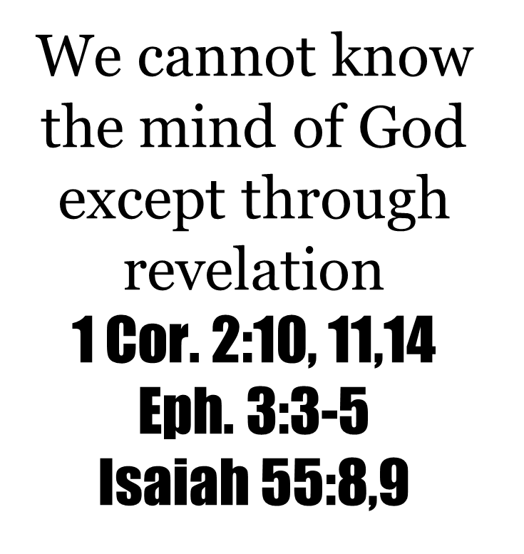
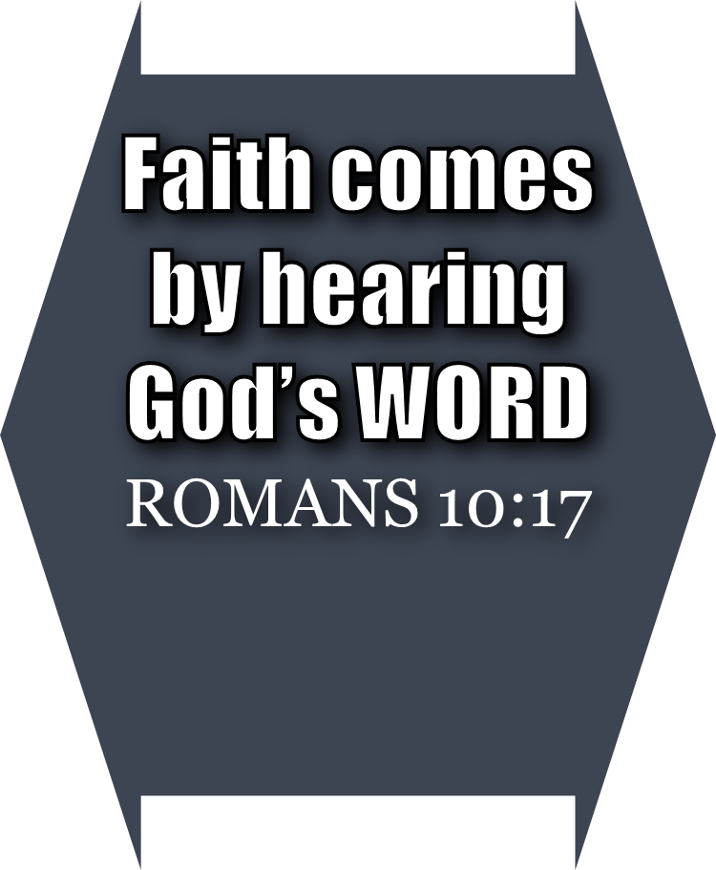

Walking by faith means walking by what God has said
2 Corinthians 5:7; 1 Corinthians 4:6; Galatians 1:6-9; 1 Peter 4:11

Slide 9

The Bible Is Only Valid Source
Why do we believe what we believe?
We Dare Not Act Where God Has Not Spoken
2 Corinthians 5:7; 1 Corinthians 4:6; Galatians 1:6-9; 1 Peter 4:11
Cain (Genesis 4:7; Hebrews 11:4)
Nadab and Abihu (Leviticus 10:1,2)
Moses (Numbers 20:8-24)
King Saul (1 Samuel 13 & 15)
David’s Ox Cart (1 Chronicles 13:7-12; 15:2)
Jeroboam (1 Kings 12:25-33)
Uzziah (2 Chronicles 26:16-23)
Deuteronomy 4:2; 12:32
Joshua 1:7
Proverbs 30:6
Revelation 22:18,19

Slide 10
The Search For Truth
Why do we believe what we believe?
“These were more fair-minded than those in Thessalonica, in that they received the word with all readiness, and searched the Scriptures daily to find out whether these things were so. Therefore, many of them believed, and also not a few of the Greeks, prominent women as well as men.” (Acts 17:11-12)

Slide 11
The Search For Truth
Why do we believe what we believe?
“Be diligent to present yourself approved to God, a worker who does not need to be ashamed, rightly dividing the word of truth.” (2 Timothy 2:15)

Slide 12

Why do we believe what we believe?
We MUST READ God’s word. (Deuteronomy 17:19; Joshua 8:34; Nehemiah 8:8; Luke 10:26; Ephesians 3:4-5; Colossians 4:16; etc.)
We MUST STUDY God’s word; i.e., we MUST HANDLE IT CORRECTLY. (2 Timothy 2:15; Hebrews 5:11–14)

Slide 13
Why do we believe what we believe?
Realize TRUTH matters.
(John 8:32; 1 Peter 1:22)
Humility / meekness.
(Matthew 5:3-5; James 1:21; John 7:17)
Develop a love & hunger for God and His word. (Matthew 5:6)
Desire to please Him. (Colossians 1:10)
Zeal – Be diligent in your search for truth – being honest with the Bible. (2 Timothy 2:15; Acts 17:11)

Slide 14
Why do we believe what we believe?
The totality of information revealed regarding any belief, teaching, or practice is the TRUTH regarding that belief, teaching, or practice.
  Psalms 119:160
  2 Timothy 1:13
  2 Peter 1:3

Slide 15
Why do we believe what we believe?
Truth is not contingent upon one's belief in it, altered by ones rejection of it, or nullified if no one accepts it
TRUTH IS TRUTH
(John 17:17; Psalms 19:7-9; 119:9, 11, 104)

Slide 16
Why do we believe what we believe?
If you feel that the truth is NOT the truth – no matter how strong those feelings may be –
THE TRUTH IS STILL THE TRUTH!
(John 17:17; Psalms 19:7-9; 119:9, 11, 104)

Slide 17
Why do we believe what we believe?
If you feel that a LIE is the truth – no matter how strong that feeling may be –
A LIE IS STILL A LIE
& THE TRUTH IS STILL THE TRUTH!
(John 17:17; Psalms 19:7-9; 119:9, 11, 104)

Slide 18
Why do we believe what we believe?
Anything different from the truth – is NOT the truth –
TRUTH IS NARROW!
(Matthew 7:13-14)
TRUTH IS ABSOLUTE!
(Psalms 119:151-152)
TRUTH IS VALUABLE!
(Proverbs 23:23)
(John 17:17; Psalms 19:7-9; 119:9, 11, 104)

Slide 19
Why do we believe what we believe?
What Should We Believe About:
How a lost sinner can be saved?
(Romans 10:17; 10:9,10; Acts 17:30; 2:38; Hebrews 3:14)
The church Jesus built?
(Matthew 16:18; Acts 2:47; Ephesians 5:24)
What God accepts as true worship?
(John 4:24; Acts 20:7; Ephesians 5:19)
The organization and work of the church (Philippians 1:1; Acts 20:28; Ephesians 4:11-16; 1 Corinthians 11:22, 34)

Slide 20
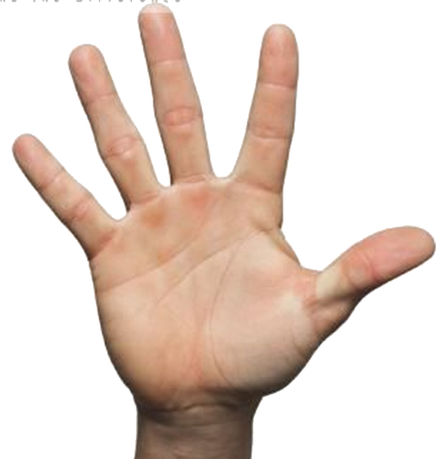

Repent
The Plan of Salvation
Believe
What
Must I
Do To Be
Saved?
Confess
Romans 10:17
John 8:24
Acts 17:30
Romans 10:9,10
Acts 2:38
1 Corinthians 15:58
Hear
Endurance
Be Baptized
Notes:
Invitation—Plan of Salvation

Slide 21
Why Do We Believe
What We Believe?
THE SOURCE
THE SEARCH
THE METHOD
THE APPLICATION
THE RESULT
When we believe,
teach and
practice ONLY
what is taught in
the Bible, we
KNOW we are
pleasing to God!
Acts 17:11-12

Slide 22

John 20:26-27
“And after eight days His disciples were again inside, and Thomas with them. Jesus came, the doors being shut, and stood in the midst, and said, "Peace to you! Then He said to Thomas, "Reach your finger here, and look at My hands; and reach your hand here, and put it into My side. Do not be unbelieving, but believing.”

Slide 23
John 20:28-29
“And Thomas answered and said to Him, My Lord and my God! Jesus said to him, Thomas, because you have seen Me, you have believed. Blessed are those who have not seen and yet have believed.”

Slide 24
How Faith Relates to Your Feelings
Bill Scott, a West Virginia preacher, relates an incident told by a helicopter pilot who flew from an aircraft carrier in the Pacific.
“I was flying the helicopter back to the ship when a blinding fog rolled in. Flying at a low altitude, I knew that a single mistake would plunge my crew and me into the ocean. Worse yet, I was experiencing a complete loss of balance — which is common for pilots flying by instruments. This loss of balance was so bad that despite the instrument readings I was certain that I was lying on my side.”
“For 15 minutes.” the pilot agonized as he relied solely on his instruments. He admitted that he fought” the urge to turn it according to my feeling.” Then suddenly when they broke safely through the fog, he said, “I was deeply thankful I had been trained to rely upon my instruments rather than on my feelings.”
Religiously, too many people rely on undependable and fleeting feelings. Erwin W. Lutzer was right when he wrote, “A Christian life based on feeling is headed for a gigantic collapse.” Or crash.
I’ve had Christians say, “I don’t feel saved,” because the fog of doubt, discouragement or even despair has enveloped them. They’re allowing a temporary emotion to cloud what they know is true.
On the other hand, I’ve heard of people basing their salvation on some hyper-emotional experience. One lady described her salvation experience at a religious revival as an out of body experience. She said she felt like she was floating on air. She felt as light as a feather. She felt something she’d never experienced. She felt like she was saved.
When a preacher questioned if she really was floating, she admitted she wasn’t. He delicately asked the slightly over-weight woman, if she was as light as a feather, she curtly replied, “No.” “Well maybe you’re not saved either, the preacher suggested.
The Bible teaches that “we walk by faith and not by sight” (2 Cor. 5:7). Faith is the solid foundation of our eternal hope. The Bible says, “Now faith is the assurance of things hoped for, the conviction of things not seen” (Heb. 11:1).
Furthermore, our faith is founded on facts. We’re not flying blindly into clouds. We have our “instruments,” to guide us. God’s revealed Word. The Bible tells us that we’ve all sinned and fallen short of God’s glory (Rom. 3:23). But He loves us and wants us to be saved (Jn 3:16). That’s why Jesus Christ died for our sins (Rom 5:8). And his triumphant victory over death through his resurrection assures us that we too will be raised (1 Cor. 15).
The book of Acts tells the story of salvation. People who received God’s saving grace heard the Gospel of Christ. Believed. Repented of their sins. And were baptized for the remission of sins (Acts 2). As a result, God added them to the body of the saved, called the church (Acts 2:47). Those are the facts.
Interestingly, when people by faith obeyed the gospel, a good feeling followed. Sinners saved like the Ethiopian Treasurer “went on their way rejoicing.” Your conscience will be clean and clear (1 Peter 3:21). Like the man who found the lost sheep or the woman who found the lost coin, you will share your excitement with others (Lk. 15:7-10).
Faith generates joy (Phil. 1:25). And even allows us to face life’s troubles and trials with a joyful spirit (1 Pet. 1:7-9). There will even be occasions, like in the parable of the prodigal son, where a Christian goes astray. Leaves the Father. And goes into the far country of sin. But when the wayward one returns there will be tears of joy. And a celebration when they come home.
True Christianity is not devoid of emotion. But our feelings are based on faith and rooted in the reliable facts of the gospel. Objective Truth must be subordinate to our feelings, moods, and opinions.
The connection between these concepts is summed up in this short verse by an unknown author.
Three men were walking on a wall,
Feeling, Faith and Fact,
When Feeling got an awful fall,
And Faith was taken back.
So close was Faith to Feeling
He stumbled and fell too,
But Fact remained and pulled Faith back,
And Faith brought Feeling too.
–Ken Weliever, The Preacherman

